Slide 1
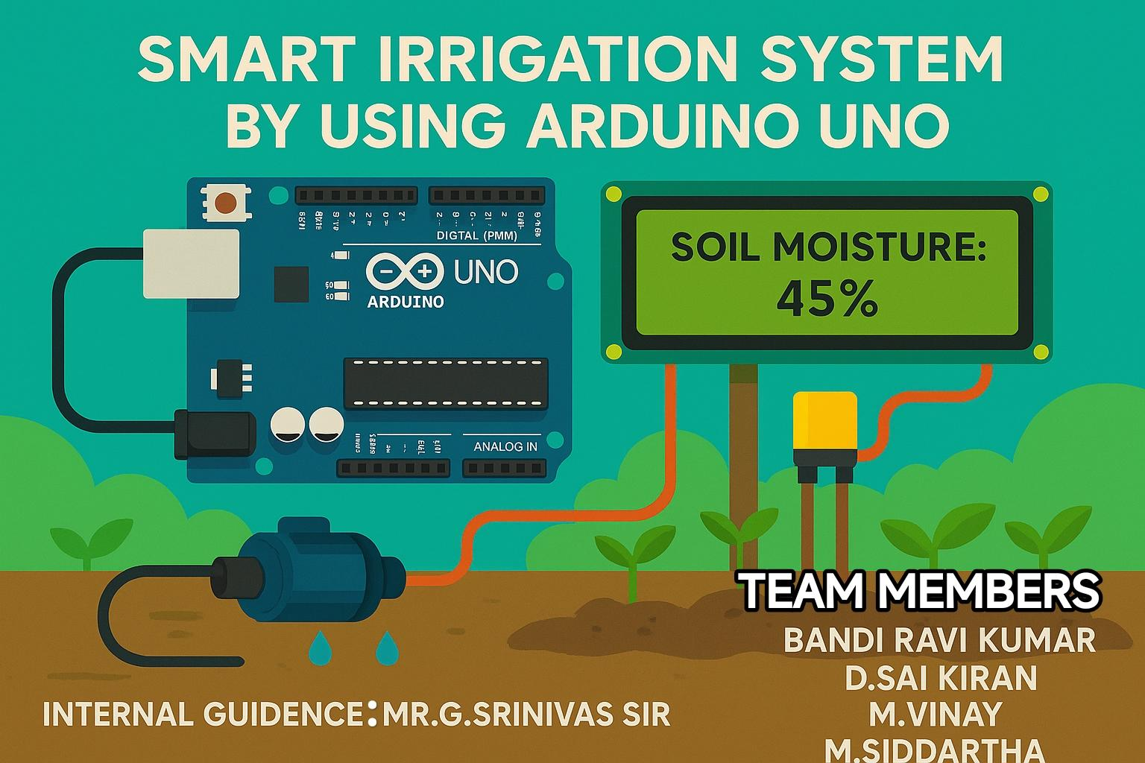

Slide 2
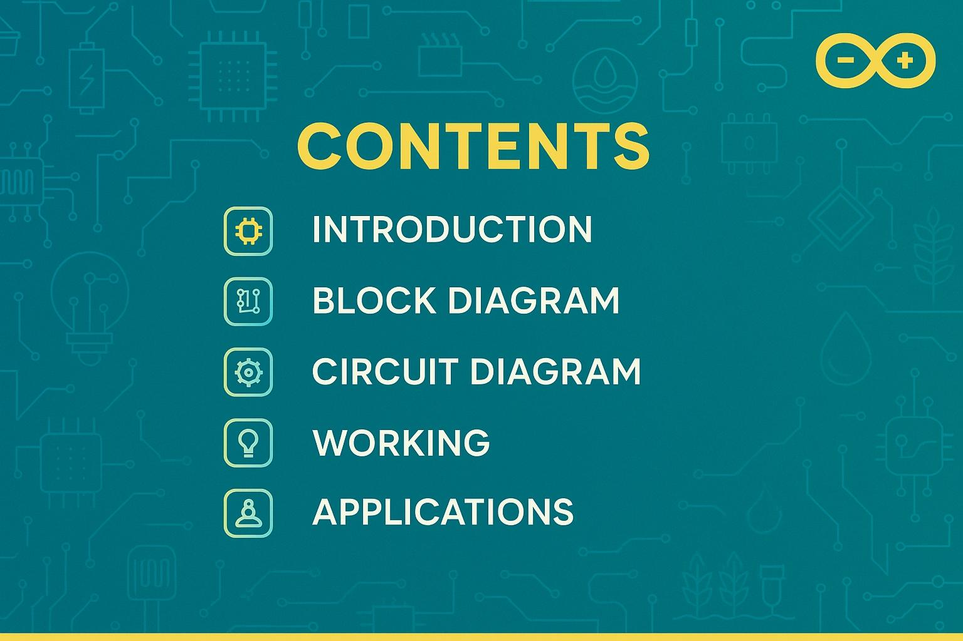

Slide 3
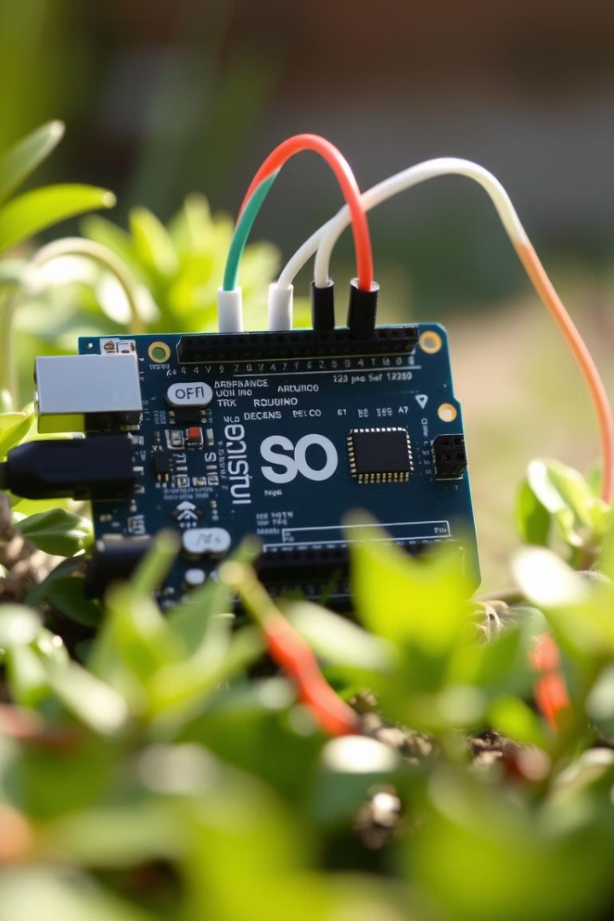
Smart Irrigation System using Arduino UNO
This presentation explores the design and implementation of an automated irrigation system. It leverages the Arduino UNO platform for efficient water management. We will delve into its components, functionality, and future potential.

Slide 4
Problem Statement: The Need for Smart Irrigation
Water Scarcity
Inefficient Practices
Time Consumption
Many regions face critical water shortages. Traditional irrigation wastes significant amounts of water.
Manual watering often leads to over- or under-irrigation. This harms plants and depletes resources.
Regular garden maintenance requires consistent time and effort. Automation frees up valuable time.

Slide 5
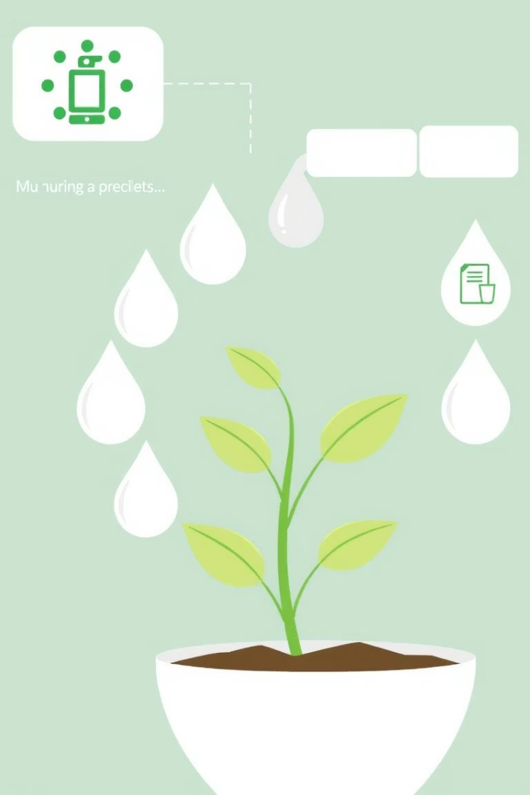
Proposed Solution: Automated Irrigation System Overview
1
Automated Watering
2
Resource Conservation
Our system delivers water precisely when needed. It adapts to plant requirements.
It minimizes water waste. This promotes sustainable gardening practices.
3
Improved Plant Health
Optimal moisture levels lead to healthier, more vibrant plants. This enhances growth.

Slide 6
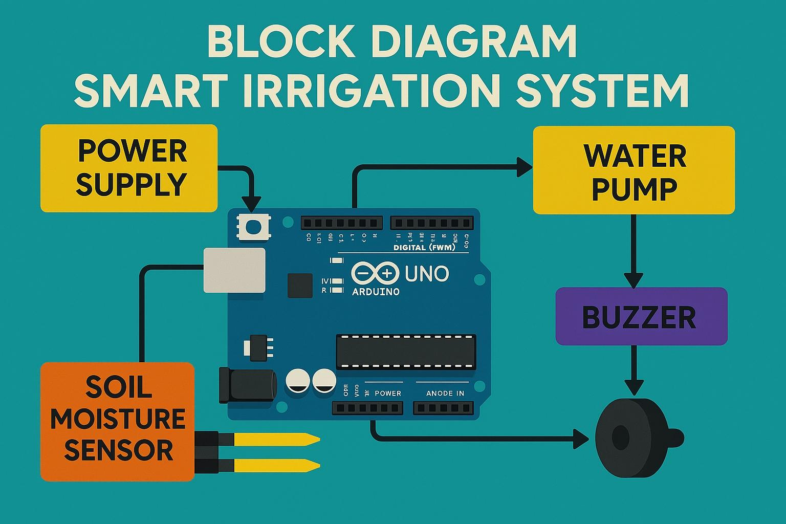

Slide 7
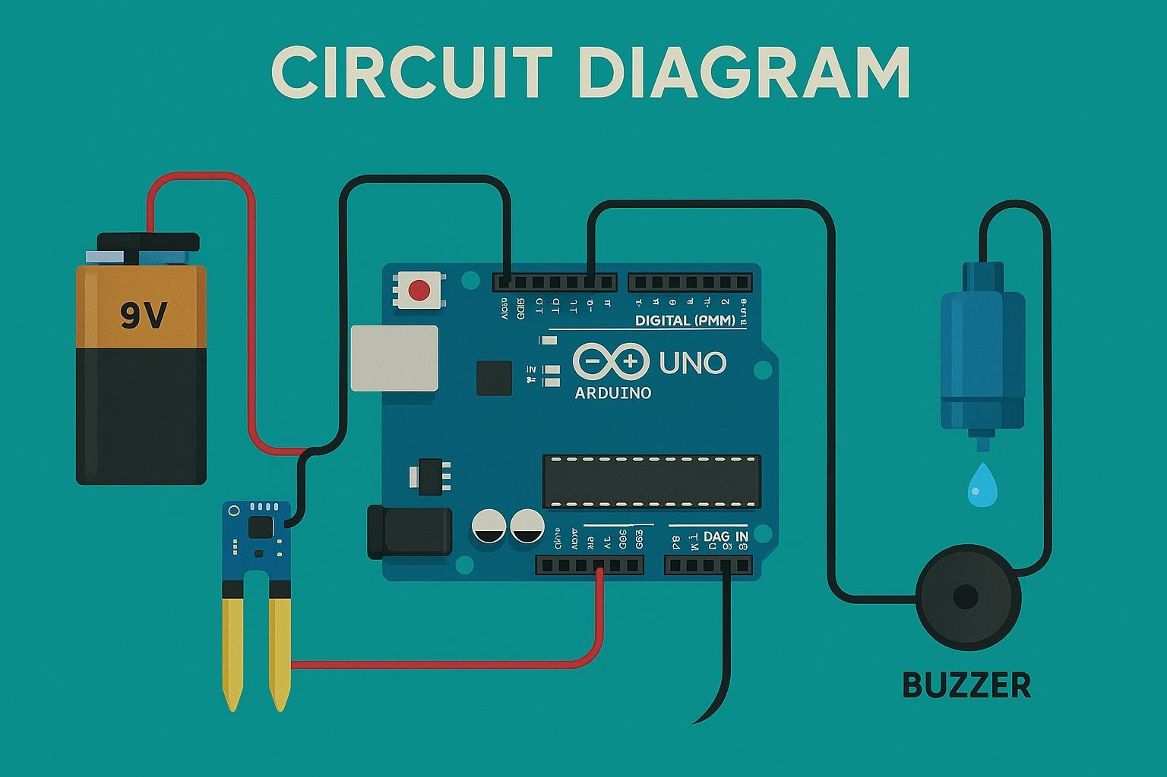

Slide 8
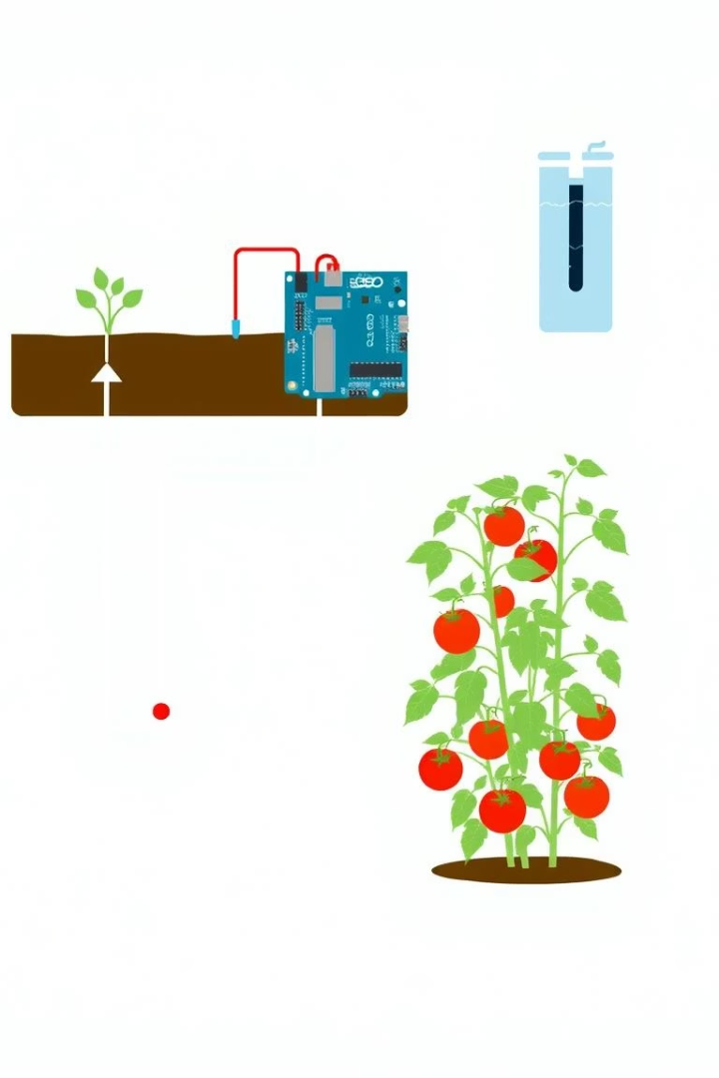
System Architecture: Hardware and Software Components
Hardware
Software
Arduino UNO microcontroller
Arduino IDE
Soil moisture sensor
Custom C++ code
Water pump
Serial Monitor for debugging
Relay module
Logic for sensor readings
Connecting wires
Connectivity
USB for programming
Digital/Analog pins
Power supply
Sensor input lines

Slide 9
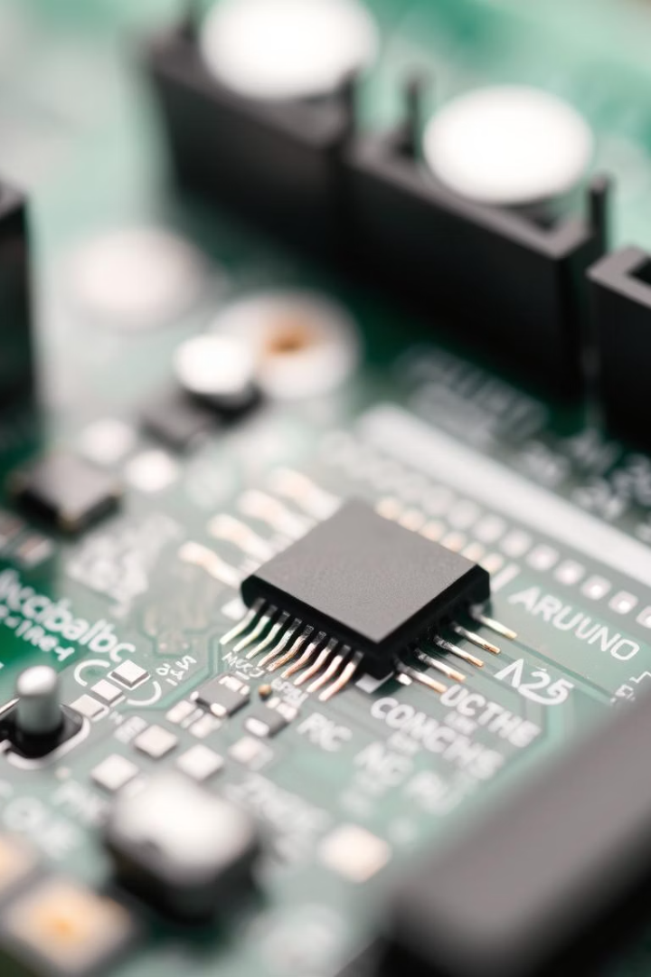



Arduino UNO: The Brain of the System
Microcontroller
Connectivity
Programming
The Arduino UNO processes sensor data. It executes the irrigation logic.
It offers versatile input/output pins. This allows for sensor and actuator integration.
Easily programmable via Arduino IDE. It supports C/C++ language.

Slide 10








Sensors and Actuators: Soil Moisture, Water Pump
Soil Moisture Sensor
Threshold Logic
Detects the moisture content in the soil. It sends analog signals to Arduino.
If moisture falls below a set threshold, irrigation activates. This prevents dehydration.
Relay Module
Water Pump
Safely switches the high-power pump. It protects the Arduino board.
Actuator for water delivery. Controlled by Arduino via a relay.

Slide 11
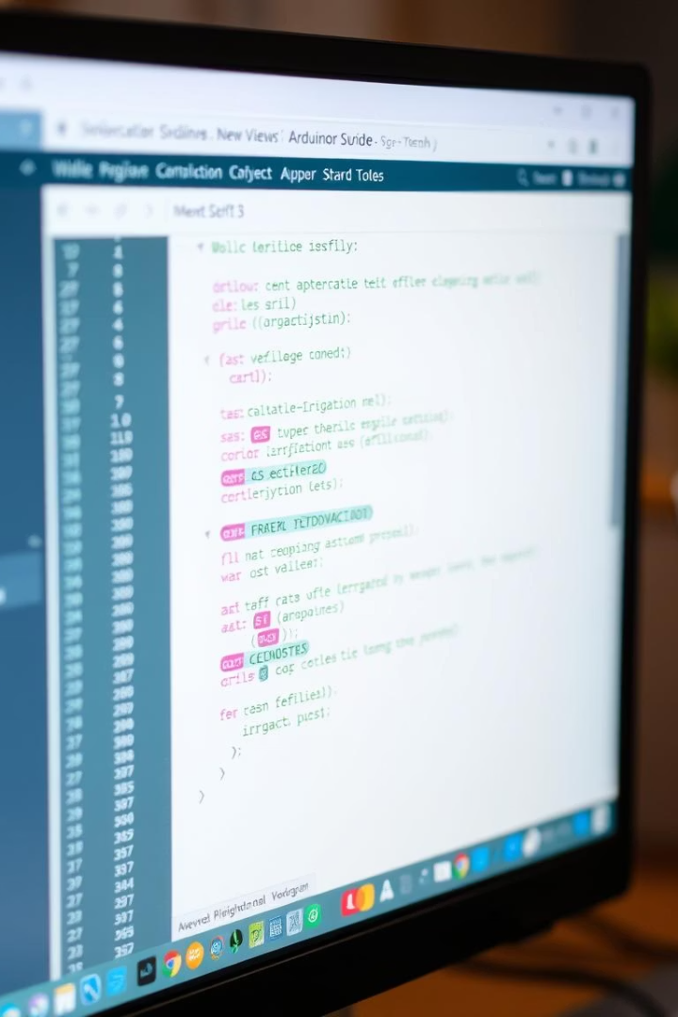




Software Implementation: Arduino IDE Programming
Setup Function
Initializes pins and serial communication. Runs once at startup.
Loop Function
Continuously reads sensor data. Executes irrigation logic.
Calibration
Adjusts moisture thresholds for different plants. Ensures precise watering.
Debugging
Uses Serial Monitor for real-time data. Helps in troubleshooting.

Slide 12
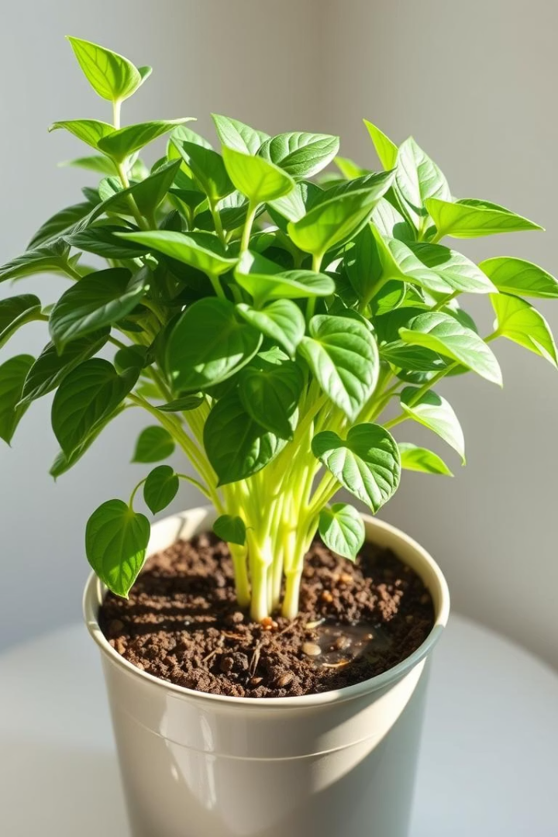



Results and Discussion: Performance Evaluation
Water Savings
Reduced water consumption by 30%. Less waste.
Healthier Plants
Consistent moisture improved plant growth. No more wilting.
Ease of Use
System operates autonomously. Minimal user intervention.

Slide 13




Future Enhancements: Scalability and Improvements
IoT Integration
1
Remote monitoring via web/mobile app. Control from anywhere.
Weather Data
2
Integrate rainfall forecasts for predictive watering. Avoid over-watering.
Multiple Zones
3
Expand to manage multiple garden areas. Different plant needs.
Solar Power
4
Make the system energy self-sufficient. Environmentally friendly.

Slide 14

Conclusion: Benefits and Impact of Smart Irrigation
Foundation for Future Innovation
Enhanced Gardening Experience
Sustainable Resource Use
This project serves as a robust prototype. It can inspire further smart home automation.
Our system promotes responsible water management. It conserves precious resources.
Automated care means less effort for gardeners. Enjoy thriving plants.

Slide 15


